Slide 1
ATOMS and ELEMENTS
All non-living things are made up of countless microscopic particles called ATOMS.
The middle of each atom is called a NUCLEUS, which contains nucleons. Some nucleons are uncharged particles (called neutrons). But the rest of them are positive charges, called PROTONS.
Moving around this nucleus are negative charges, called ELECTRONS.
The number of electrons around an atom always equals the number of protons in its nucleus.
A certain ELEMENT is simply an ATOM of a certain CHEMICAL. The number of protons in its nucleus decides exactly which chemical it is.

Slide 2
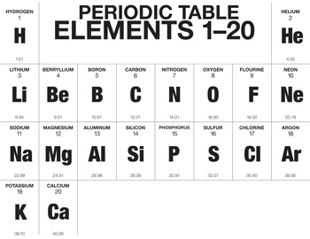
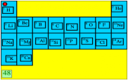
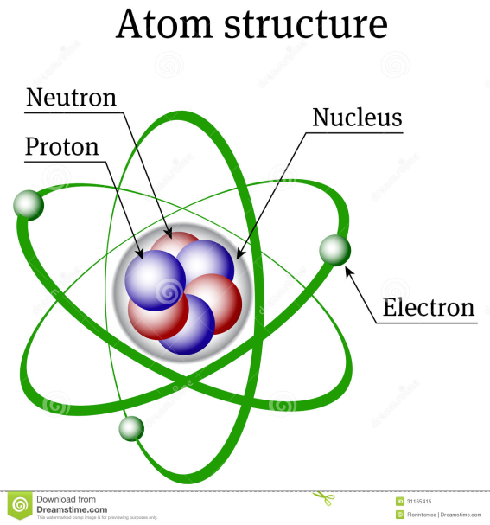
THE FIRST TWENTY ELEMENTS
GROUPS: 1 2 3 4 5 6 7 8
PERIODS: 1
2
3
4

Slide 3
WHAT WE MUST KNOW
Fully understand the structure of the first twenty elements.
(Remember: H and He are alone in their line.)
Know the NAME of each of these first 20 chemicals.
ALSO names of: Cr, Mn, Fe, Cu, Zn, Br, Ag, I, Hg, U.
Vertical Rows ↕ are called GROUPS. For us, there are 8.
Group No. (1)8 is called the Inert or Noble Gases, because they cannot react.
Horizontal Rows ↔ are called PERIODS. (That is why it is called the Periodic Table.)For us, there are 4 periods.
Each chemical has an Atomic Number. This tells us how many Protons are in the nucleus of that chemical. (The number of protons always EQUALS the number of electrons. This is why the atom is never charged.)
Metals are on the left of the Periodic Table. Non-metals on the right. Semi-metals form a diagonal line between them.

Slide 4
WHAT TO DO NOW:
In your Summary Book, copy the Periodic Table of the first 20 elements from the slide (using the one in your text book to guide you).
Write the numbers 1 to 20 down your margin. Next to each, write its chemical symbol. And then its name.
In the same way, copy the following ten symbols down your page, and name each of them:
Cr, Mn, Fe, Cu, Zn, Br, Ag, I, Hg, U.

Slide 5
MOLECULES and COMPOUNDS
When 2 or more atoms are joined to each other, we call it a MOLECULE.
If they are chemicals that are joined, we call it a COMPOUND.
So can you see: a COMPOUND is when 2 or more elements are joined to each other.
Examples: Making Compound called water: H + H + O → H2O
PhotoSynthesis: H + H + O + C + O + O → CH2O + O2
Respiration: C + H + H + O + O + O → H2O + CO2
See other models of compounds on page 30.

Slide 6
CHEMICAL FORMULAE of COMPOUNDS
A chemical formula shows all the symbols in that chemical, and the number of atoms of each element in that chemical.
H2O = 2 atoms of H, all joined with 1 atom of O.
CH4 = 1 atom of C, joined to 4 atoms of H.
H2SO4 = 2 atoms of H, 1 atom of S, 4 atoms of O.
Now: if you have 5 molecules of a chemical, you put the 5 in front of the symbol for that chemical.
So: 5H2O = 5 molecules of water.

Slide 7
NAMING COMPOUNDS
When we studied the Periodic Table, we saw that the metals are on the left, non-metals are on the right, and a diagonal line of semi-metals separates them.
RULE 1
A metal will react with a non-metal to produce a compound. When you name that compound, the name of the metal stays as it is. The name of the non-metal will change, only by adding –ide onto its name.
Na2S = Sodium + Sulfur = Sodium Sulfide
See the Table on Page 30 for more examples.
For Oxides: 1 Oxygen = Mon- 2 = Di- 3 = Tri-
CO = Carbon MonOxide. CO2 = Carbon DiOxide
CO3 = Carbon TriOxide

Slide 8
RULE 2
A metal can join onto a combination of more than one other element. The metal still keeps its own name, but the combinations have specific names.
(See the Top Table, Page 31.)
(Na)OH = HydrOxide (Ag)NO3 = Nitrate
(Fe)SO3 = Sulfite (Ca)SO4 = Sulfate
(Cu)CO3 = Carbonate NH4(Cl)= Ammonium
Some common chemicals have been given their own nicknames. (See the Bottom Table, Page 31:)
Water. Salt. Baking powder. Laughing gas. Petrol.

